Slide 1

Water quality prediction
DATA 606
Capstone in Data Science
Project by: Rashmitha Challa(IZ48096)
rchalla1@umbc.edu
Supervised by: Chaojie (Jay) Wang, D.Sc.

Slide 2

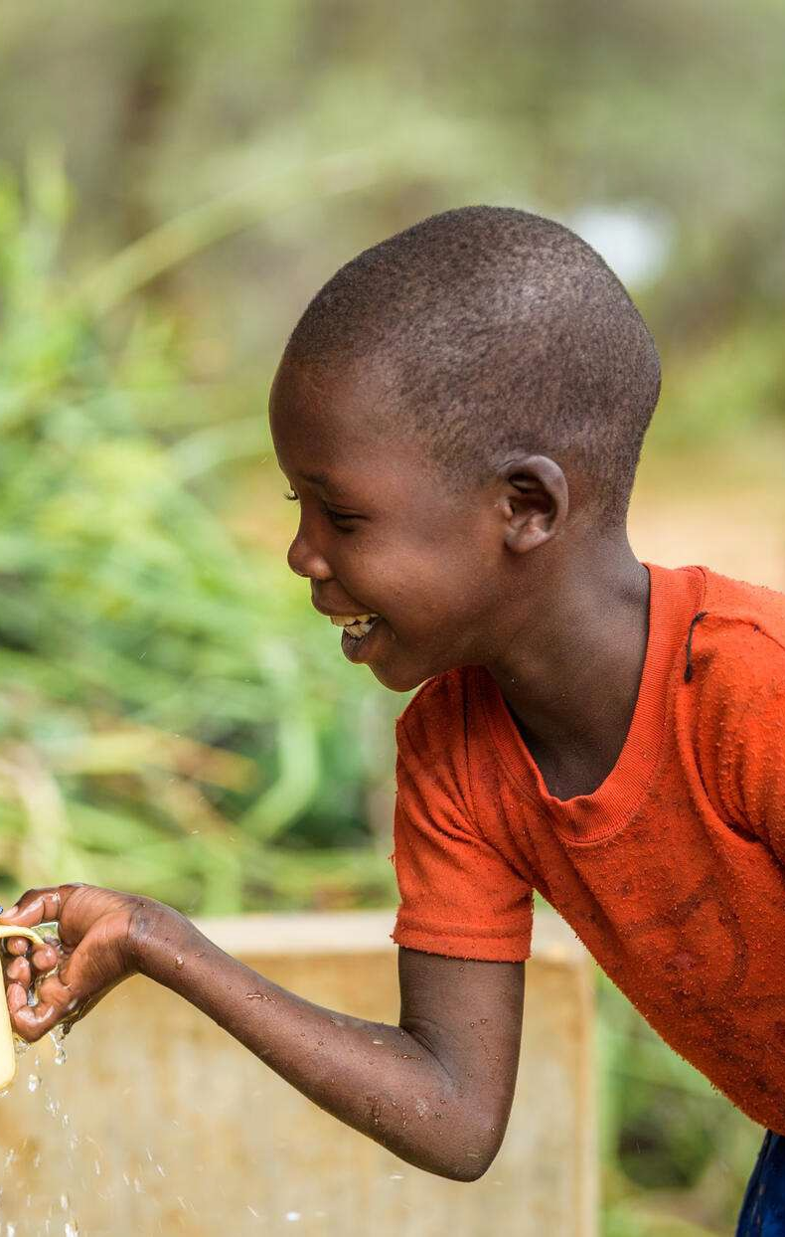
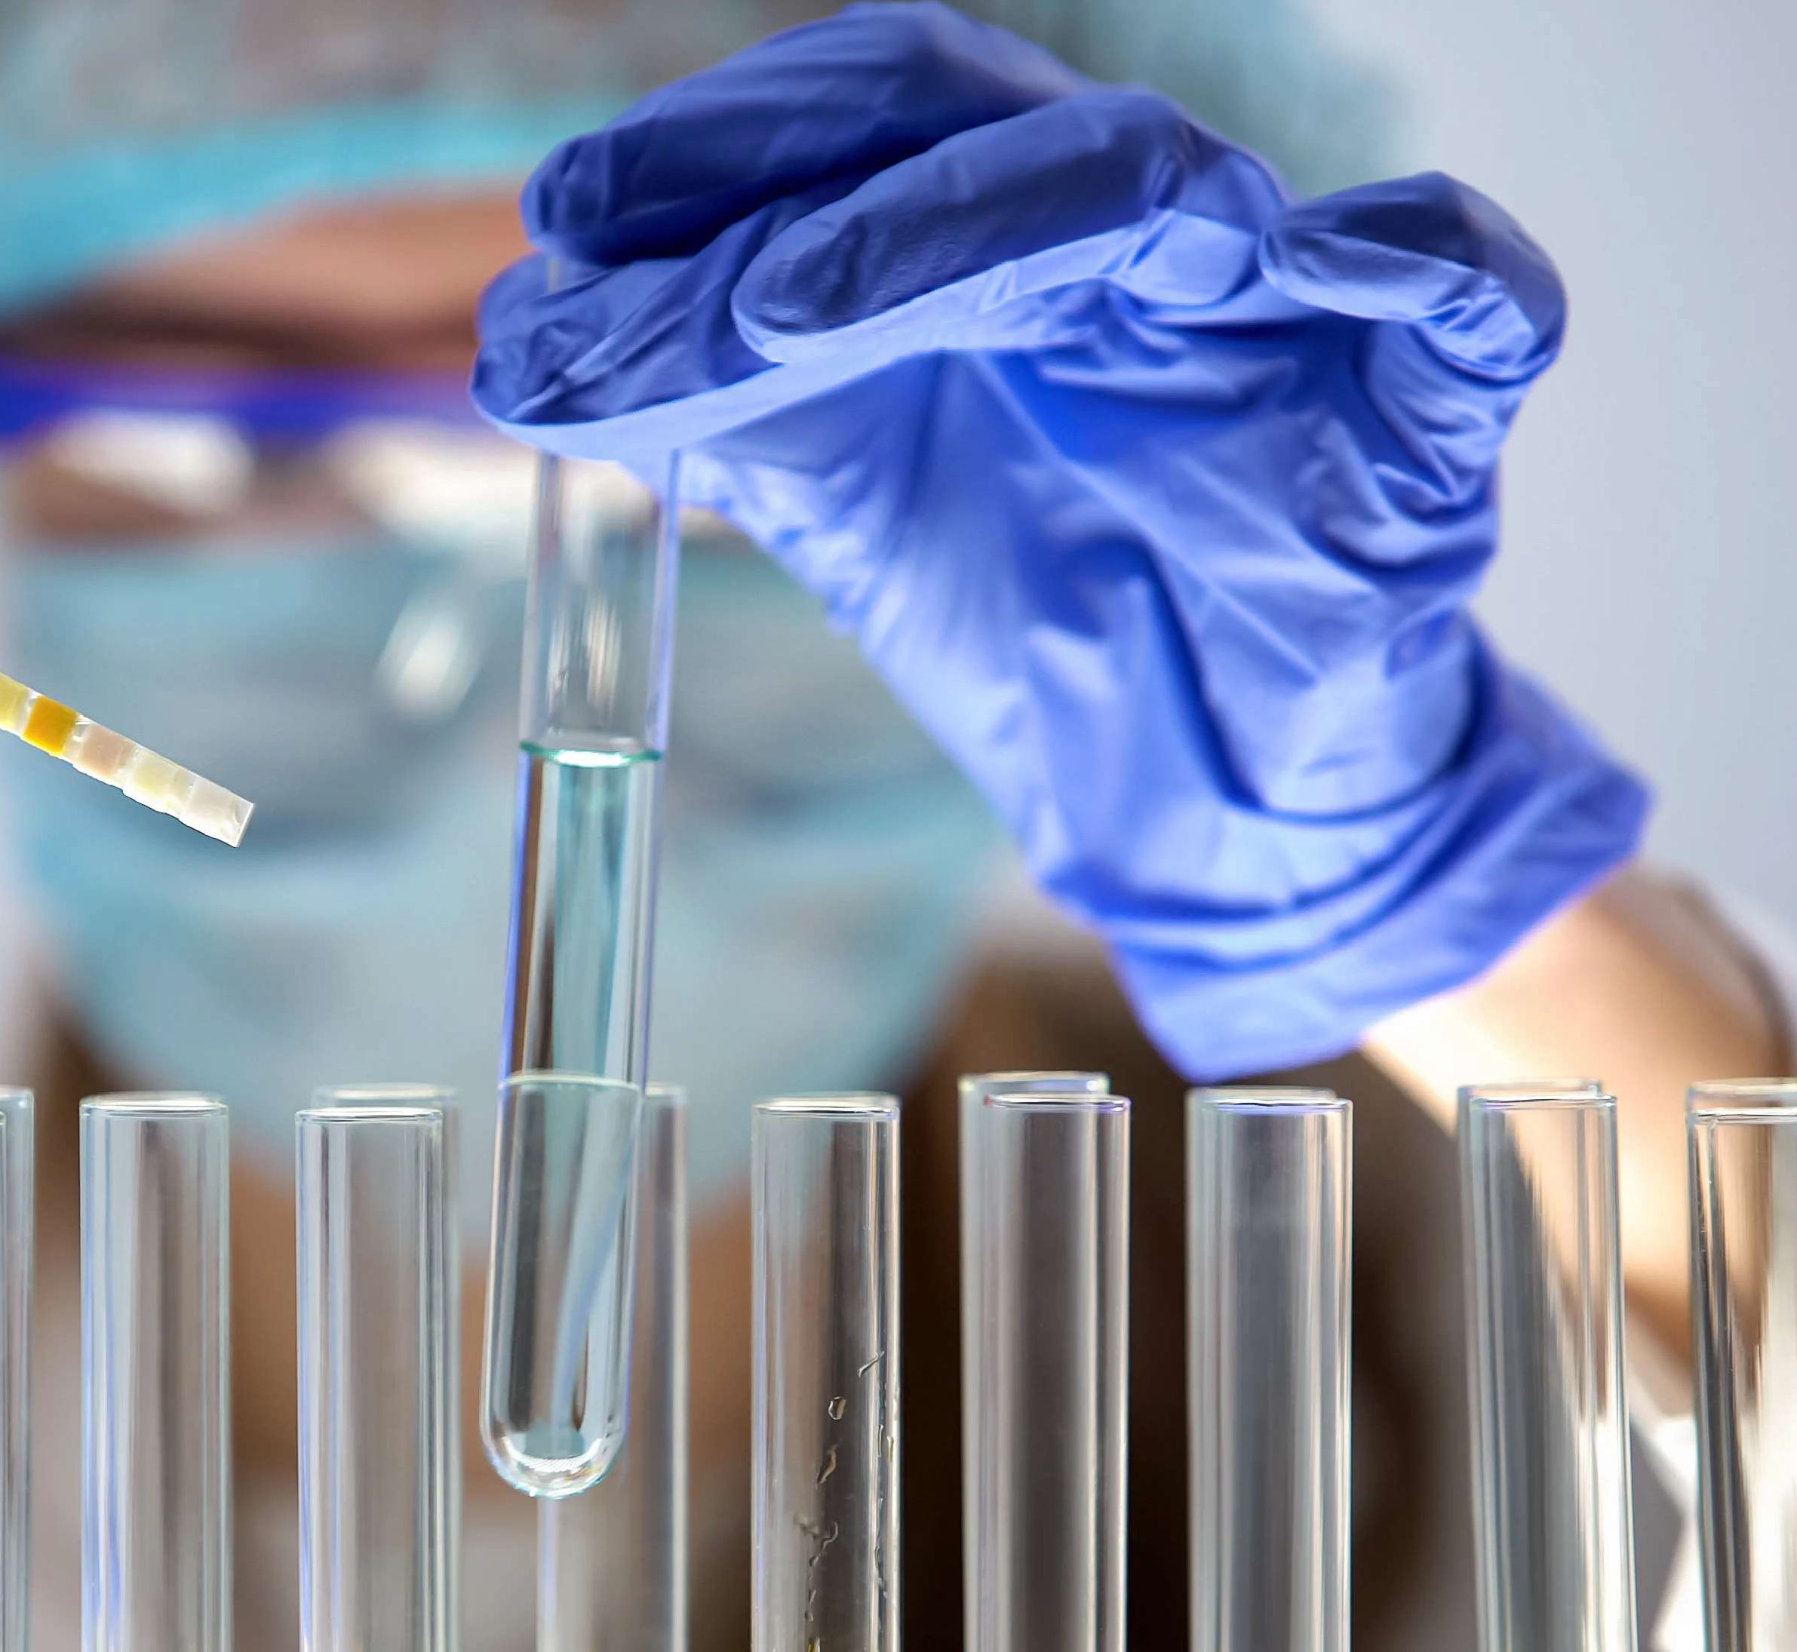
Why classify water?
Basic necessity for all human life
Process of water testing is time consuming: water collection and laboratory testing
Costly
Can machine learning improve the process of water classification?

Slide 3
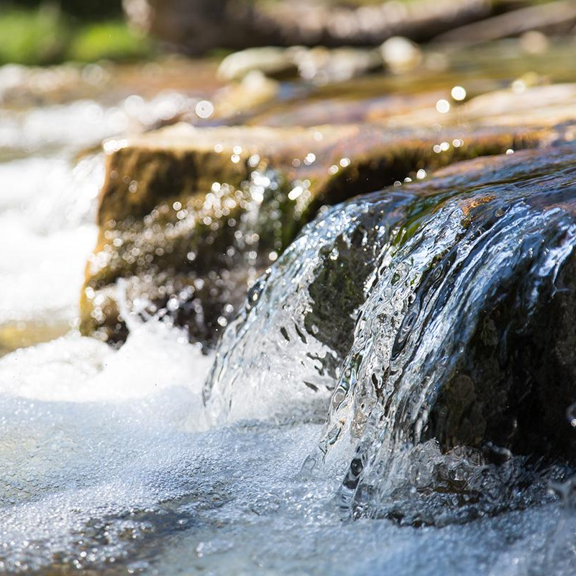
Predicting Water Potability
Can we predict water potability?
Which machine learning algorithms can yield the most efficient and accurate results?
Can the parameters within the ML algorithms be tuned to yield the best results?
Are the parameters within the dataset affective in water quality prediction?
Should there be other parameters to consider?
How confident are we in our findings?

Slide 4
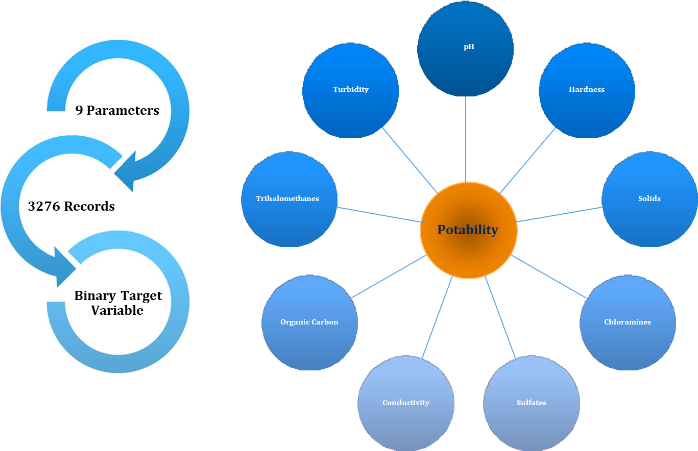
The Dataset https://www.kaggle.com/datasets/adityakadiwal/water-potability/

Slide 5
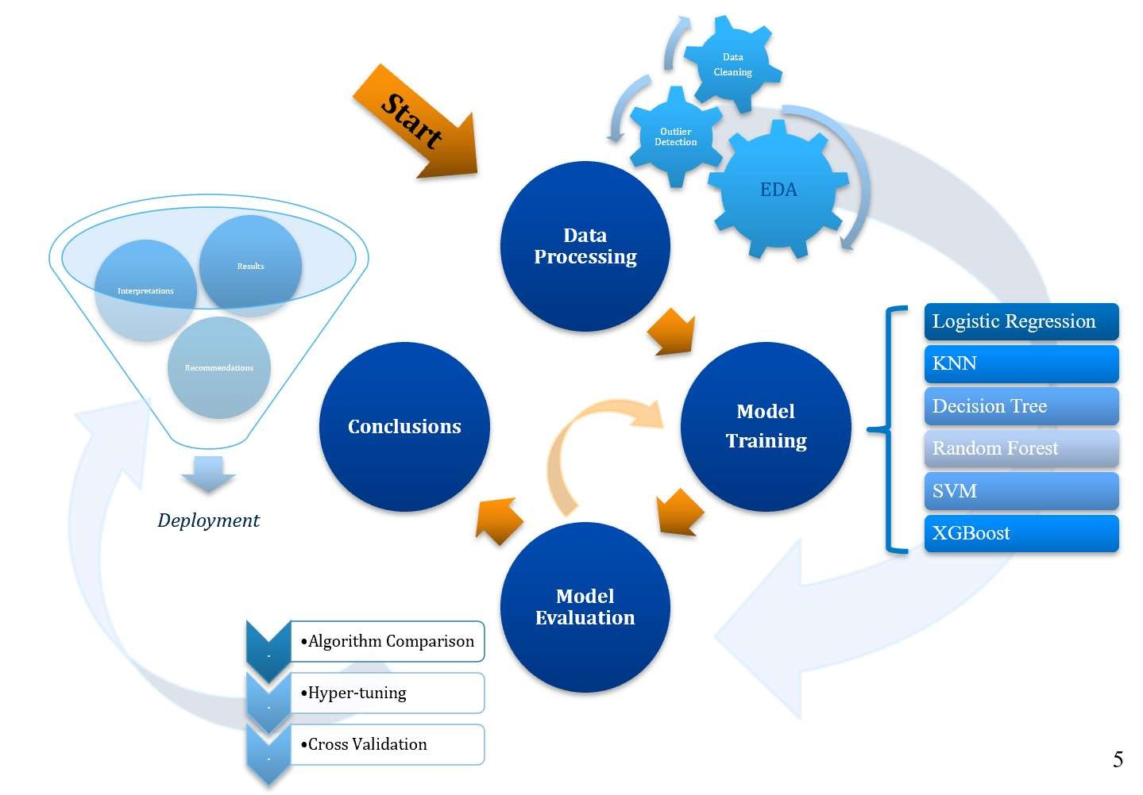
Approach

Slide 6
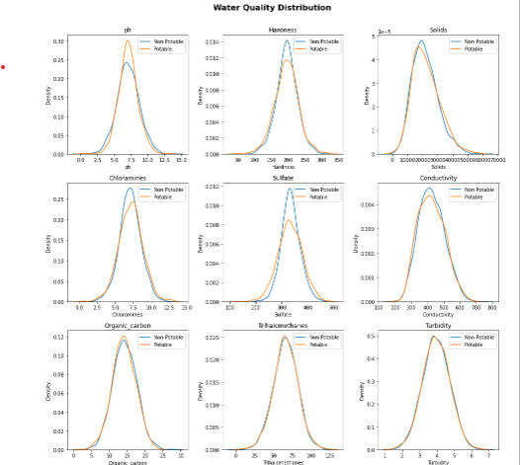
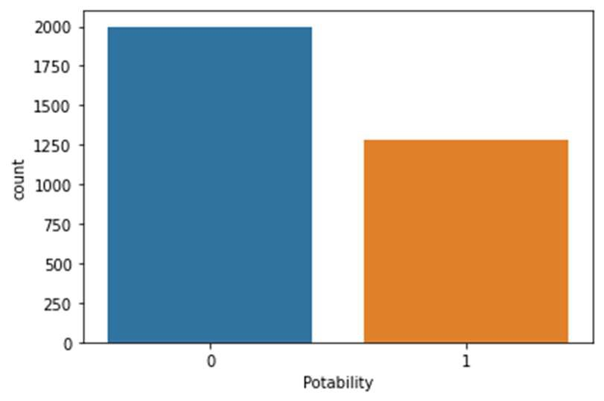
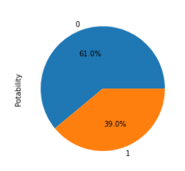
EDA: Visual Analyses
Portability Value Counts

Slide 7
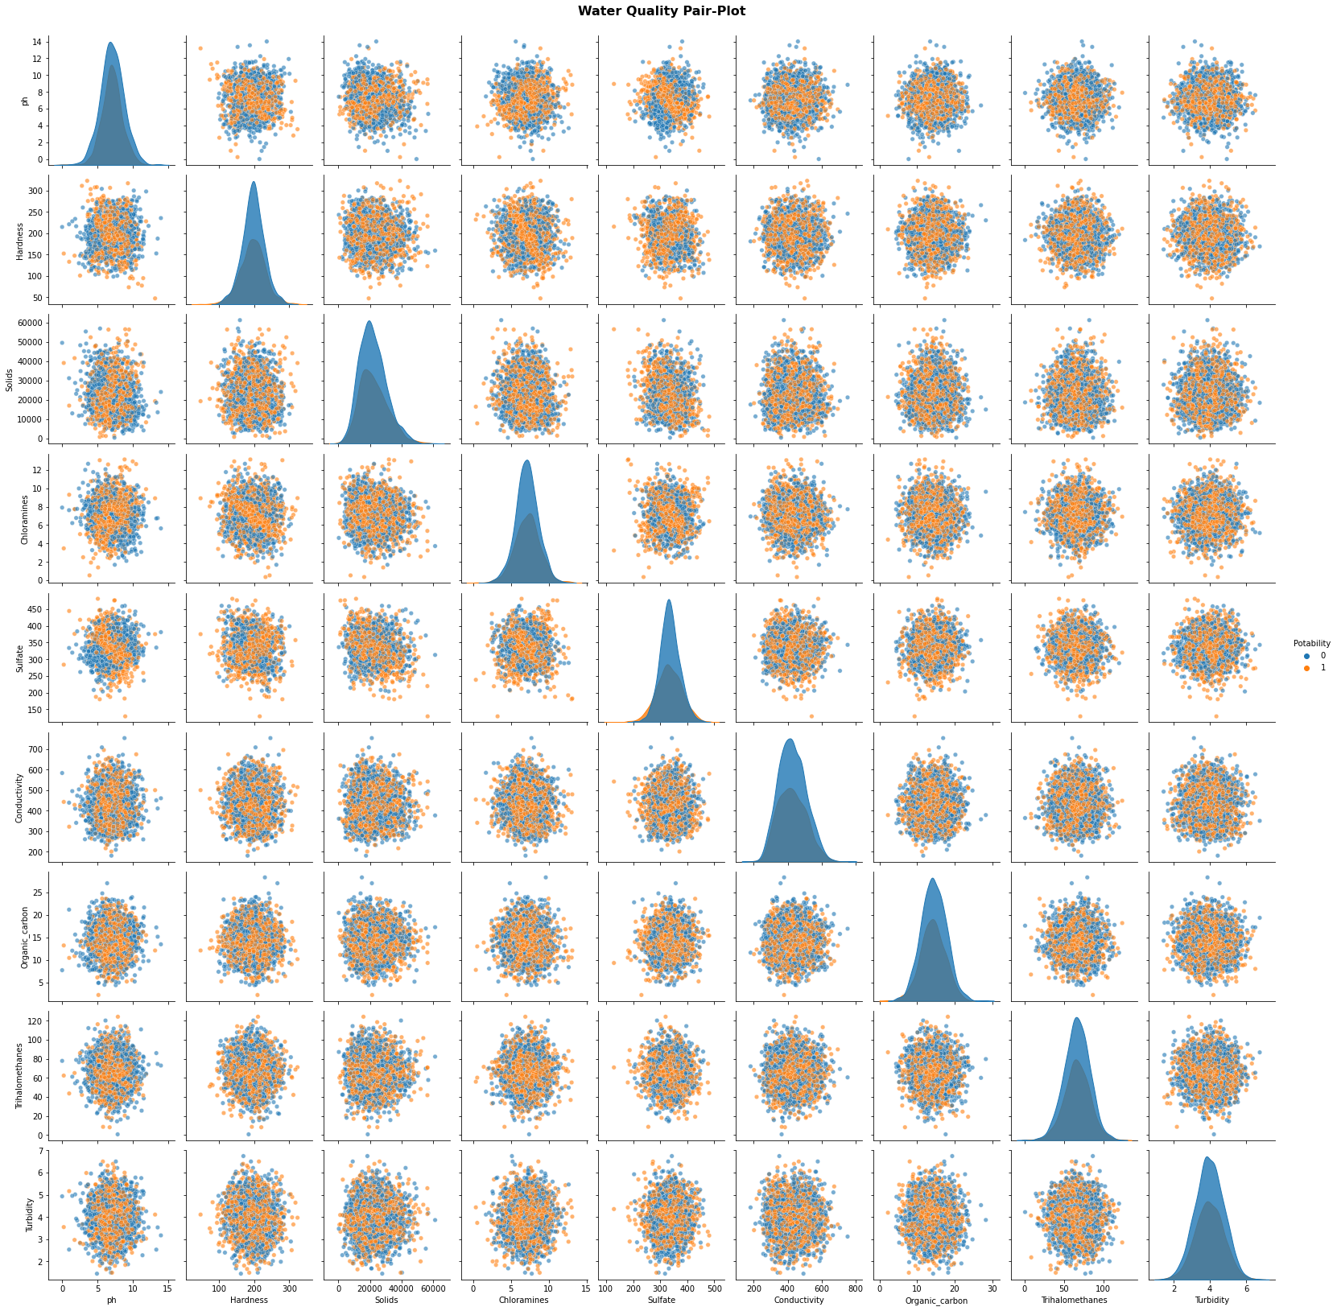
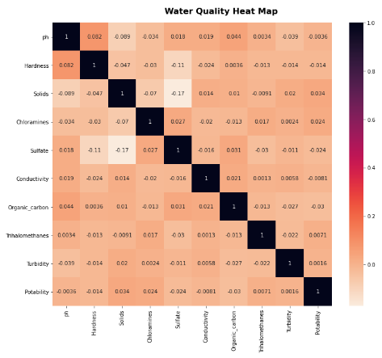
EDA: Visual Analyses

Slide 8
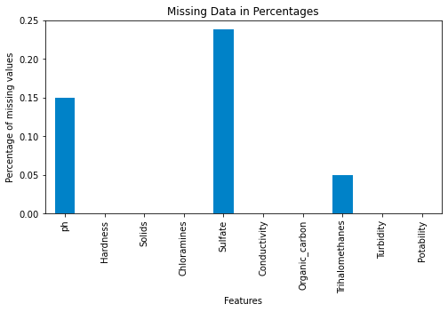
Missing Values

Slide 9
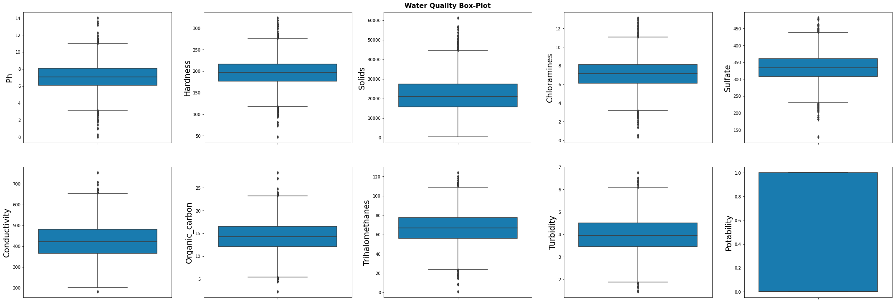
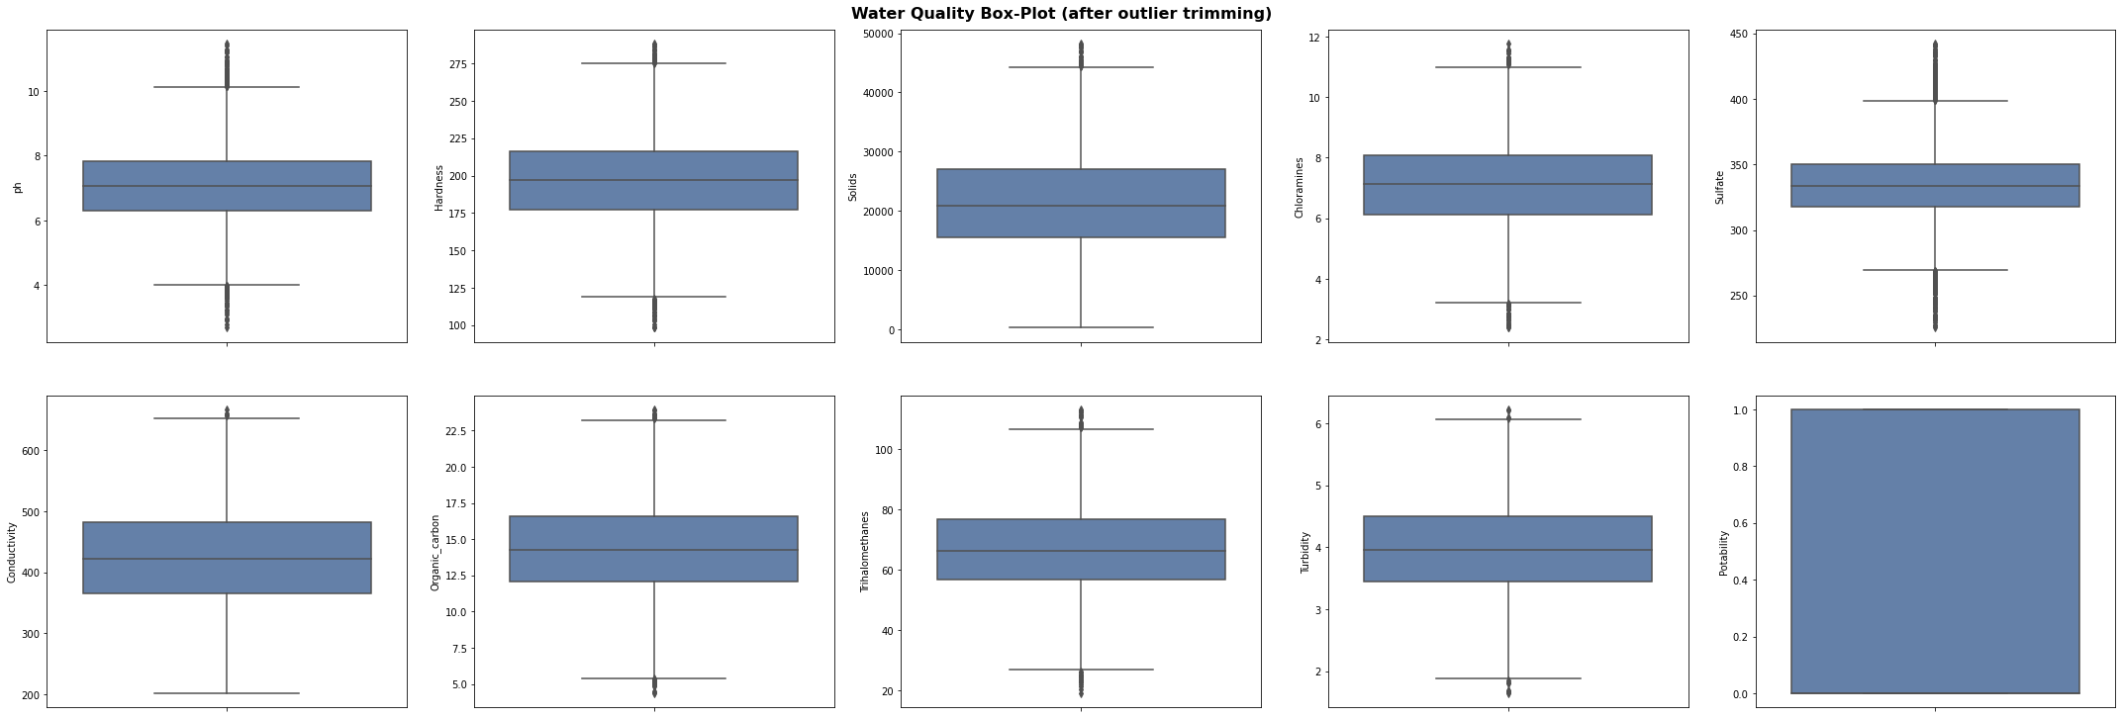
Outlier Detection

Slide 10
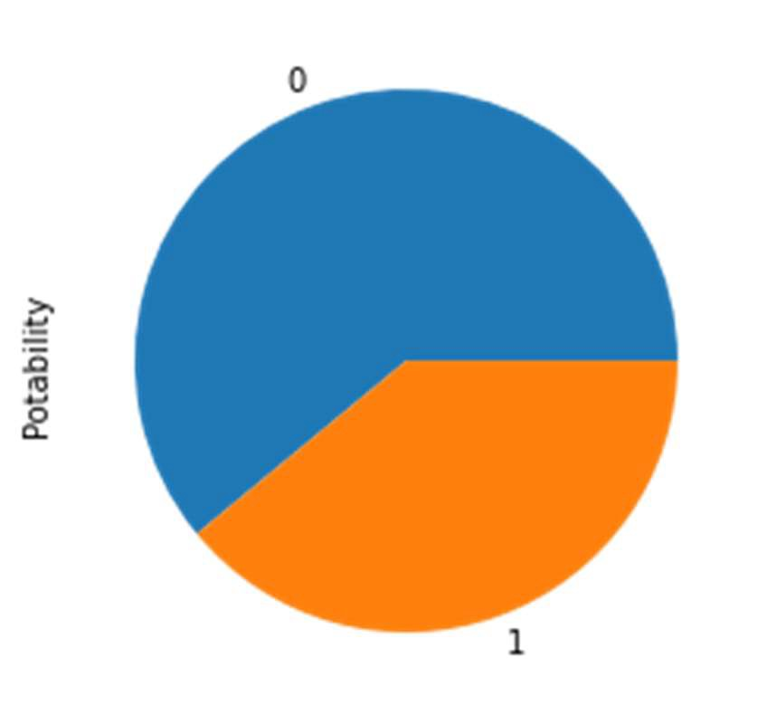
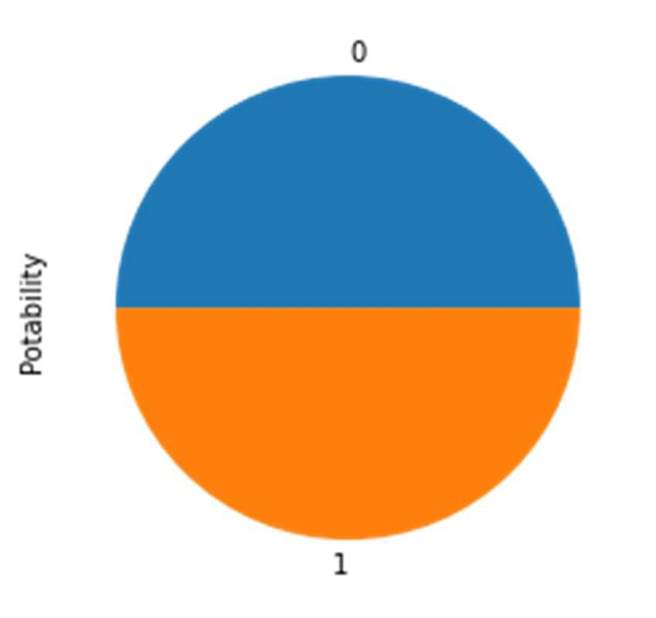
Class Imbalance
Up-sampling the minority class to balance the data for training to prevent bias to the majority class
1930/1198
1930/1930

Slide 11
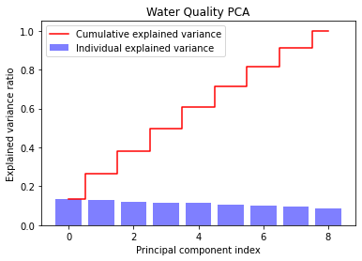
Principle Component Analysis
Exploring dimensionality reduction using PCA tells us that all the variables are independent from each other and further confirms our previous observations from the heatmap

Slide 12
Modelling algorithms
Logistic Regression
K-Nearest Neighbour Regression
Decision Tree Classifier
Random Forest Classifier
XGBoost Classifier

Slide 13
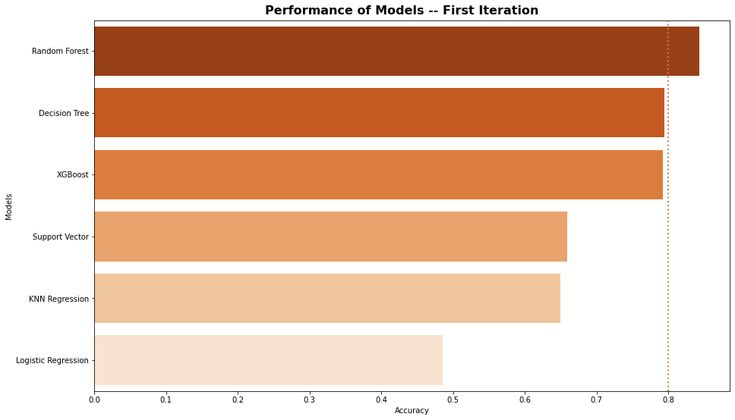
Algorithm Comparison 1st Iteration
Model | Accuracy | Precision | Recall | F1 Score
3 | Random Forest | 0.843264 | 0.838275 | 0.836022 | 0.837147
2 | Decision Tree | 0.794041 | 0.738255 | 0.887097 | 0.805861
5 | XGBoost | 0.792746 | 0.754808 | 0.844086 | 0.796954
4 | Support Vector | 0.659326 | 0.640103 | 0.669355 | 0.654402
1 | KNN Regression | 0.648964 | 0.622871 | 0.688172 | 0.653895
0 | Logistic Regression | 0.485751 | 0.470998 | 0.545699 | 0.505604

Slide 14
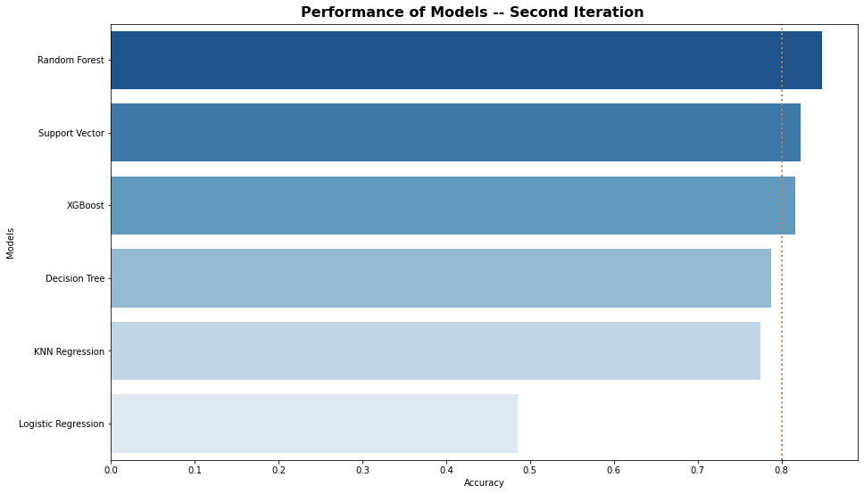
Algorithm Comparison 2nd Iteration
Model | Accuracy | Precision | Recall | F1 Score
3 | Random Forest | 0.848446 | 0.840000 | 0.846774 | 0.843373
4 | Support Vector | 0.822539 | 0.844575 | 0.774194 | 0.807854
5 | XGBoost | 0.816062 | 0.780488 | 0.860215 | 0.818414
2 | Decision Tree | 0.787565 | 0.734234 | 0.876344 | 0.799020
1 | KNN Regression | 0.774611 | 0.722973 | 0.862903 | 0.786765
0 | Logistic Regression | 0.485751 | 0.470998 | 0.545699 | 0.505604

Slide 15
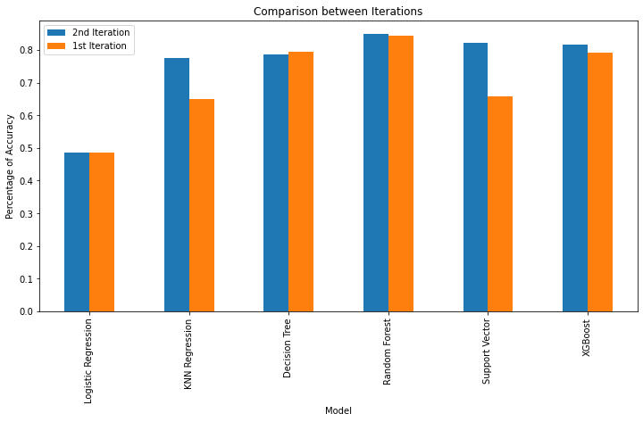
Model Evaluation
Model | 2nd Iteration | 1st Iteration | Difference in Accuracy
Logistic Regression | 48.58% | 48.58% | 0.00%
KNN Regression | 77.46% | 64.90% | 12.56%
Decision Tree | 78.76% | 79.40% | -0.65%
Random Forest | 84.84% | 84.33% | 0.52%
Support Vector | 82.25% | 65.93% | 16.32%
XGBoost | 81.61% | 79.27% | 2.33%

Slide 16
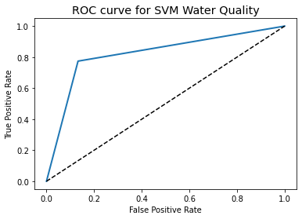
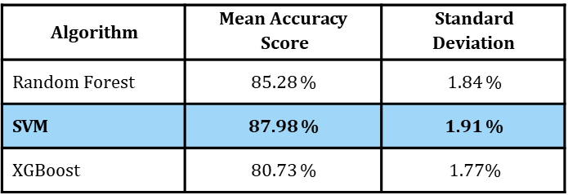
Cross Validation

Slide 17
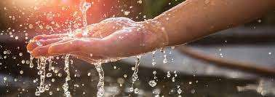
Interpretation & Recommendations
After 2nd iteration and hyper-tunning parameters, SVM performed with the greatest accuracy 82.25%
After k-Fold cross validation, SVM’s accuracy increased to 87.98%
Increasing parameters: coliforms and heavy metals
Explore deeper machine learning such as ANN (artificial neural network

Slide 18
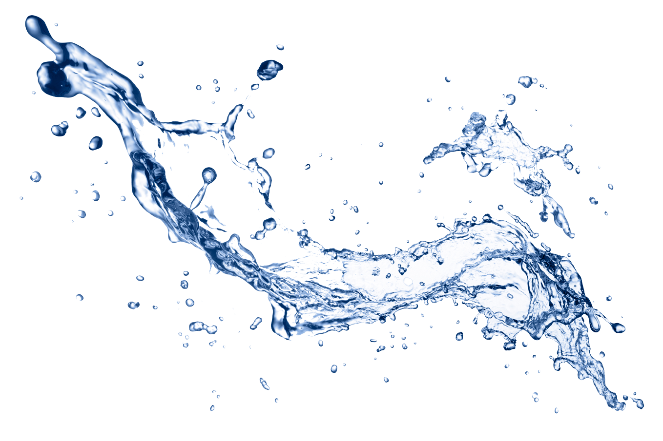
Conclusions
Can we predict water potability?
Which machine learning algorithms can yield the most efficient and accurate results?
Can the parameters within the ML algorithms be tuned to yield the best results?
Are the parameters within the dataset affective in water quality prediction?
Should there be other parameters to consider?
How confident are we in our findings?
Using ML it is possible to predict water potability
Support Vector Machine Classifier best performance 87.98% accuracy
Hyper-tunning did increased accuracy in modeling for most of the algorithms
The parameters within the dataset were affective in prediction although had low correlation
Through research from other studies, additional attributes such as coliform and heavy metals should be included
Confident in our findings but room for improvement

Slide 19


